Slide 1
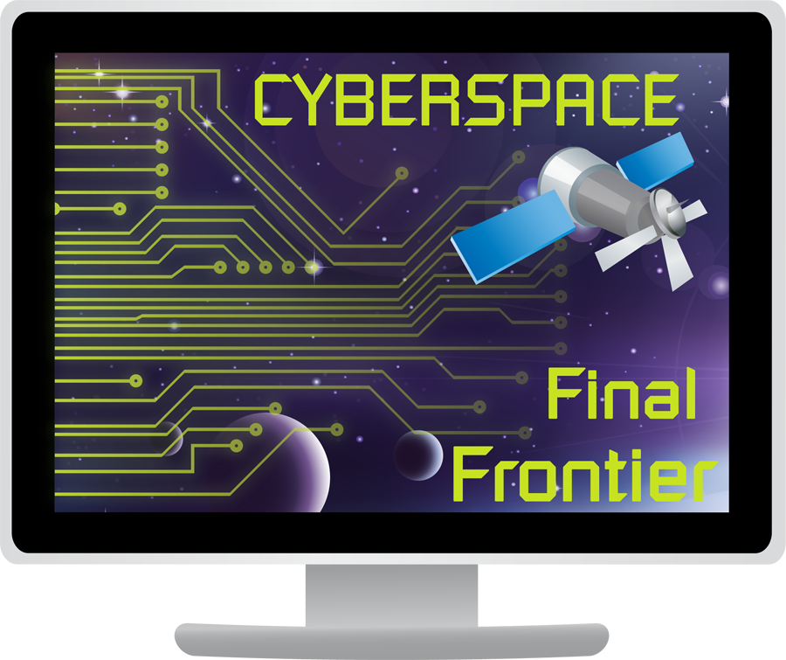
Comenius project
-Internet for Disabled People-

Slide 2
YES!
DO YOU WANT TO LEARN?
YES!
YES!
DO YOU WANT TO COMMUNICATE?
DO YOU WANT TO PLAY?

Slide 3
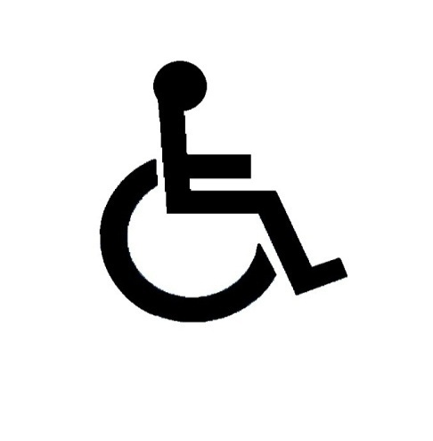
Internet for ALL
Everyday we use the Internet never thinking that there are thousands of people out in the world that have a very hard time trying to access the internet. It is important for web designers, and content authors, to understand how disabled people use the Internet, so that they do not introduce barriers that prevent disabled people from benefiting from the Internet

Slide 4
DDA
In 1995 a new era of accessibility for disabled
people began. The DDA (Disability
Discrimination Act) was passed, stating that:
It's unlawful for a service provider to
discriminate against a disabled person by
refusing to provide
any service which it provides to members of the
public.

Slide 5
So, how do disabled people access the Internet?

Slide 6
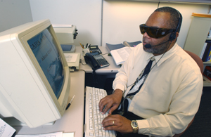
Blind users
Internet users who have no sight at all may utilize a screen reader. Screen readers load the page content (the actual HTML code plus text) from the browser’s document into a virtual buffer (special memory area).

Slide 7
Partial/poor sight
To take full advantage of the Internet, users with partial or poor sight may need to be able to enlarge the text on web pages.
Users with poor vision may also use a screen magnifier to enlarge the text size.

Slide 8
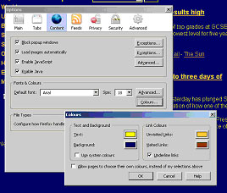
Colour blindness
It's estimated that one in 12 men and one in 200 women have some form of colour blindness.
Most modern browsers allow the user to over-ride the colour and font settings of a web site in order to make the content easier to read for people with some visual impairments.
->changing colours in Mozilla

Slide 9
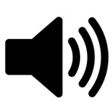
Deaf users
Most modern computer operating systems include a facility to convert the text on the screen into audio output (speech). Special applications (plug-ins) are available for web browsers that will read websites out and highlight words as they are read out

Slide 10
Useful inventions

Slide 11
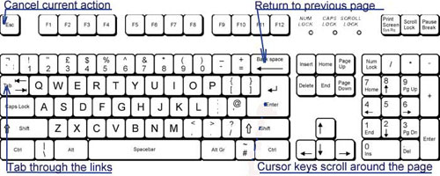
Keyboard navigation
Many disabled people cannot use a mouse. These people mostly use the keyboard for navigation. They can scroll up and down the page using the cursor keys, move through links using the tab key, go back to a previous page using the backspace key and so on.

Slide 12
Alternative Keyboards
There are a variety of alternative physical keyboards. For example, there are ergonomic keyboards for people who have hand and upper limb injuries, keyboards that present the keys in a different order (ABC rather than the conventional QWERTY), keyboards that use large keys and colour coding of the letters.

Slide 13
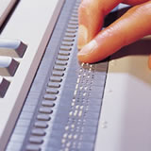
Braille Displays
Refreshable Braille displays provide a line by line tactile output of information displayed on the computer monitor. This is done by means of small, rounded pins that are lifted in order to form Braille characters.

Slide 14
Siafu
An industrial designer, Jonathan Lucas, designed a computer named Siafu with an entirely new concept that allows blind users to feel everything there is on their screen. Making use of elements named Magneclay, the computer screen can be turned into a Braille display, or even form an image .
Magneclay is an oil-based material with a loose molecular structure, when energized by an electrical charge ,these materials can change shape-shifting into a new shape indefinitely as long as electric charge is still going .

Slide 15
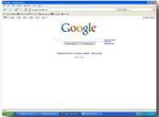
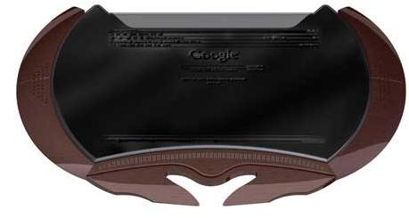
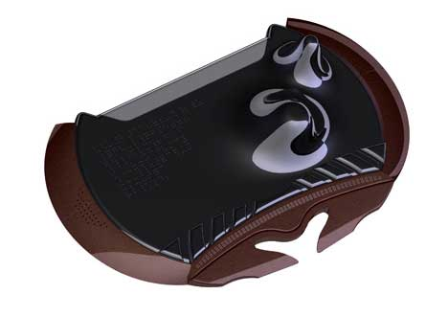

Slide 16
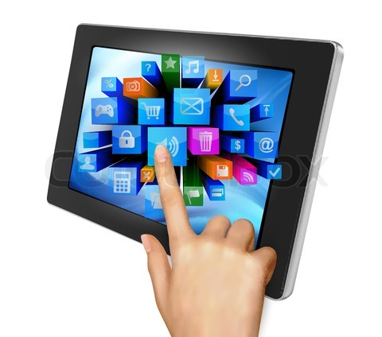
Touchpad
A touchpad allows the user to move the cursor on the screen by moving a finger across the touchpad surface. Touchpads can be used by people who are unable to hold a device such as a standard mouse or who have very limited mobility.

Slide 17
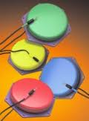
Switches
Most switches consist of one (or a few) buttons, which can be activated by bodily movement. For example, a person who can only move their head may be able to surf the Web by clicking a switch embedded in a headrest, while someone else might require a foot switch.

Slide 18
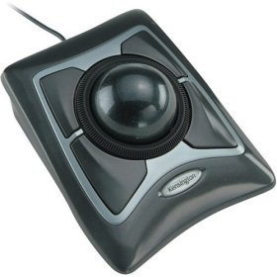
Trackball
A trackball is like an upside-down mouse, with the ball on the top and often with several buttons. With a trackball the actual device remains stationary and movement or rotation of the ball moves the cursor. The ball is usually moved with the hand, but can also be operated with the foot, elbow or a stick held in the mouth.

Slide 19
Mouth Sticks
A mouth stick is just what its name implies: a stick that is placed in the mouth. Due to its simplicity and low cost, the mouth stick is one of the most popular assistive ,,technologies”.
Mouth stick is an especially good tool for people who cannot use their hands very well.

Slide 20
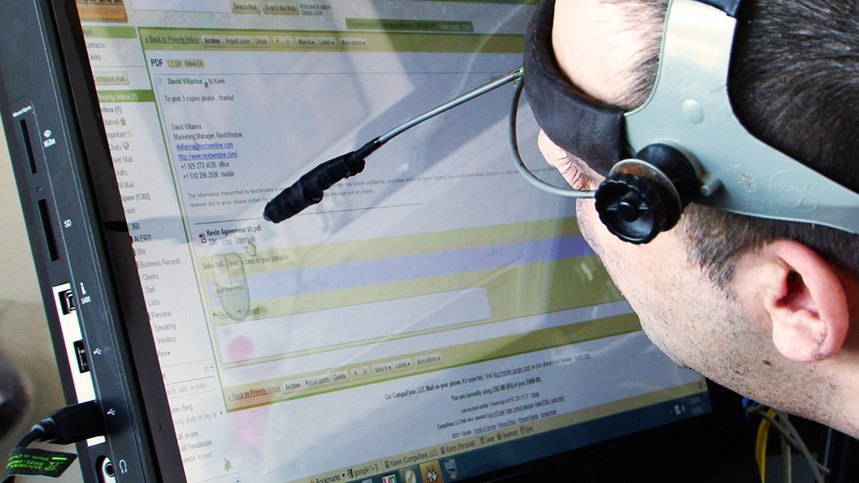
Head Wands
A Head wand is a simple device that is strapped to the users’ head, and has a protruding stick. People with severely impaired limb mobility, but who are still able to move their head, are able to effectively use websites with head wands.

Slide 21
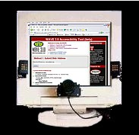
Eye Tracking
Eye tracking devices can be a powerful alternative for individuals with no control, or only limited control over their hand movements. The device follows the movement of the eyes and allows the person to navigate through the web with only eye movements.

Slide 22
In the end we would like you to close your eyes for a minute and imagine you have one of these problems and think of how hard it would be to live that way. So please support and help the disabled people in every way you can! Be a better you!

